Slide 1

SESHADRI RAO GUDLAVALLERU ENGINEERING COLLEGE
Department of Computer Science and Engineering
MINI PROJECT
On
COVID-19 Hospitals and Vaccine Management System
Under the guidance of
Dr. G. Sridevi
Associate Professor, Department of CSE
By 19481A05L8 – Sk. Farheen 19481A05O3 – V. Venkata Teja 20485A0523– V. Mohan Sai

Slide 2
Table of Contents
Abstract
Introduction
Existing method
Objectives
Implementation
Methodology

Slide 3
Abstract
COVID-19 has become a life-threatening problem. It impacted the world both socially and economically. It’s been around 2 years but still people are facing many difficulties in finding hospitals that diagnose COVID-19 and vacant beds for treatment. These days, after people get infected, they get into confusion with their health condition and availability of hospital appointments. Also, some of the patients are losing their life without proper idea about the remedies, diagnosis and hospital bed vacancy. So, to overcome this, we need a platform that gives nearby available hospital information, also to book the appointments, available beds in hospitals at their preferred locations with ease.
To stay safe from COVID-19 infection, one of the main measures, is to get vaccinated. Vaccination gives immunity to human body against coronavirus. So, each and every person has a responsibility to get vaccinated. Also, to get vaccinated there must be good visibility regarding vaccination centers and slots availability. So, it would be very helpful to have a website to know all the information and to book the vaccination slots.

Slide 4
Introduction
Our project is about creating a website that gives the information about the nearby hospitals and allows to take appointments, book beds if prescribed.
Also, to book available slots of vaccination, along with the suggestions and guidelines based on symptoms severity.
Software Required: Xampp, notepad++
Domain: Web technology
Front end: HTML, CSS, JavaScript,Bootstrap
Back end: PHP, MySQL

Slide 5
Existing Method
To monitor present COVID-19 situation we have many platforms that analyze and display statistics of COVID infected victims. Also about availability of vaccination slots and bookings.
But there’s no source to know hospitals that diagnose COVID and their availability of appointments and beds.
At present, patients have only one way of taking appointments that is by visiting hospitals, clinics which is not good for their health condition and this also leads to the rapid spread of infection.
Having platform that provides nearby hospitals’ information, beds, appointment availability collectively makes user to find all required COVID info at one place.

Slide 6
Objectives
Our COVID-19 Hospitals and Vaccine Management Website provides all related information including nearby hospitals, appointments, bed availability, vaccine slot booking at one place.
In addition to this, it also specifies the severity of infection by taking self-assessment based on the symptoms’ input given by user and provides suggestions.
Patients can easily book their appointments, without visiting hospitals at this pandemic situation.
Vaccination slots can be booked at their desired time and location online.

Slide 7
Implementation
Home page has logins for User, Admin, Super Admin along with registration for new user.
The supervisors of each hospital and vaccinated rooms are the Admins who approves the appointments and updates the information.
Super Admin is the one who adds different locations and admins to the web application, he can overall maintain the web application.
Users can find three options – hospitals info & appointments, vaccine slot availability & booking, self assessment based on symptoms.
Hospitals info – This option has a list of locations, user can choose his nearby location and request appointments if needed.
Vaccine info – This option has a list of locations, user can choose his nearby location and book time slots as required.

Slide 8
Implementation
Severity check – This option has a list of symptoms, user can choose the symptom he is suffering from, based on the selected options, web application provides some suggestions to be followed.
We created a database that contains tables for the data related to users, admins, super admins and hospitals.
For each and every hospital we have allotted a database with tables containing information of hospital, requested appointments, bed information and acceptance.
With the above implementation we were able to create a web application provides all related information including nearby hospitals, appointments, bed availability, vaccine slot booking at one place.

Slide 9
Methodology
Home Page
User Login
Registration for new users
Admin Login
Approves requests & updates information
Hospitals information
Vaccine information
Suggestions & guidelines based on symptoms
Hospital selection
Hospital details & Beds availability
Booking slots
Booking beds & appointments

Slide 10
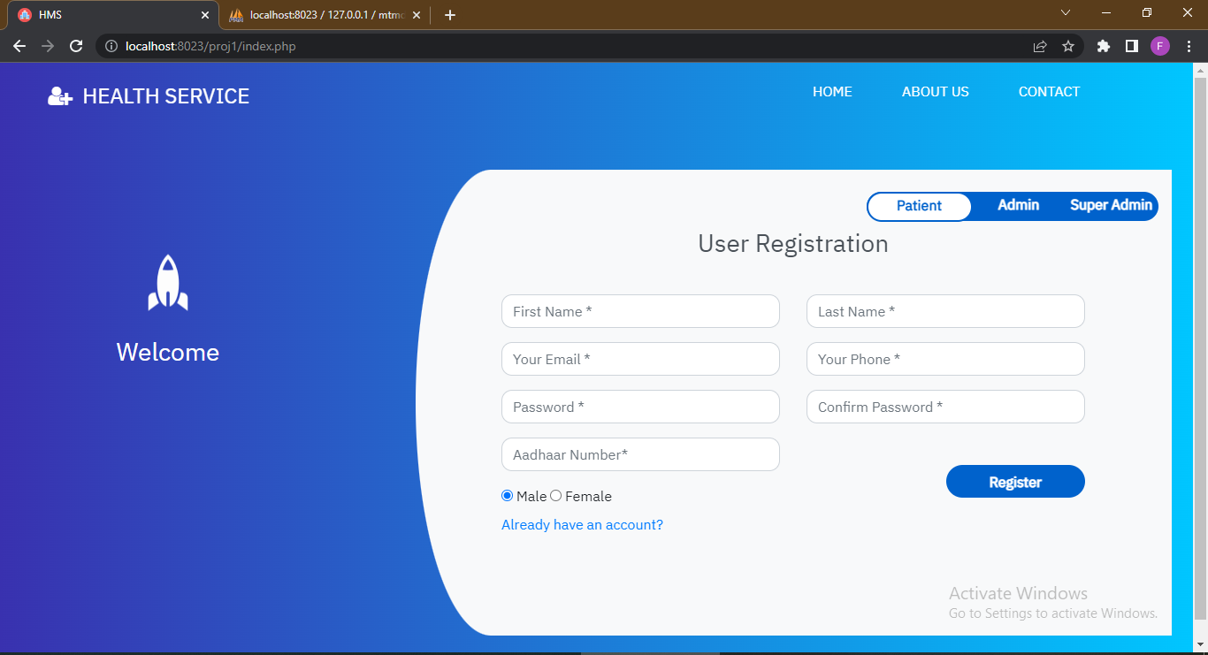

Slide 11
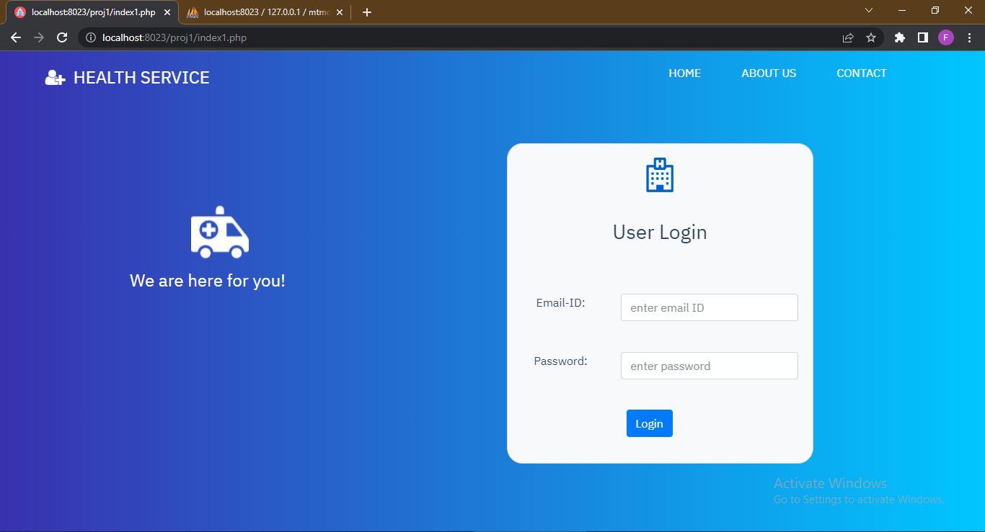

Slide 12
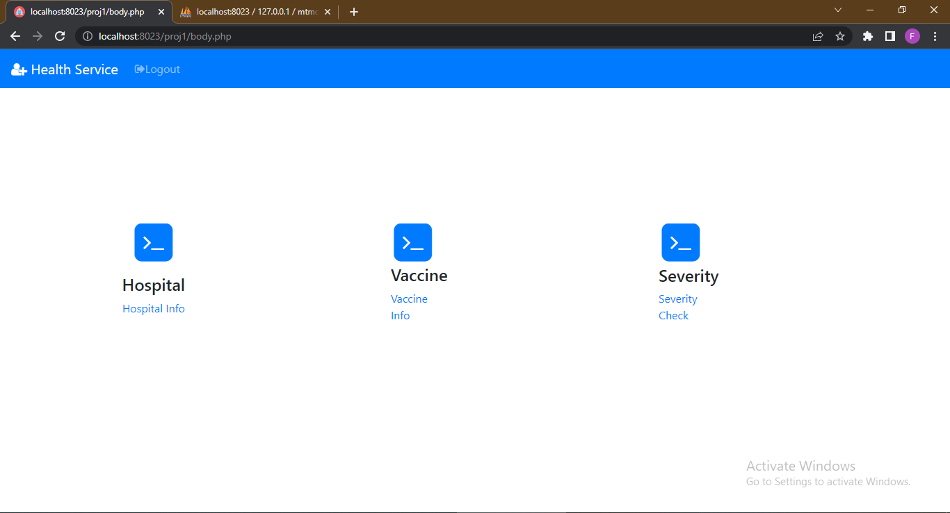

Slide 13
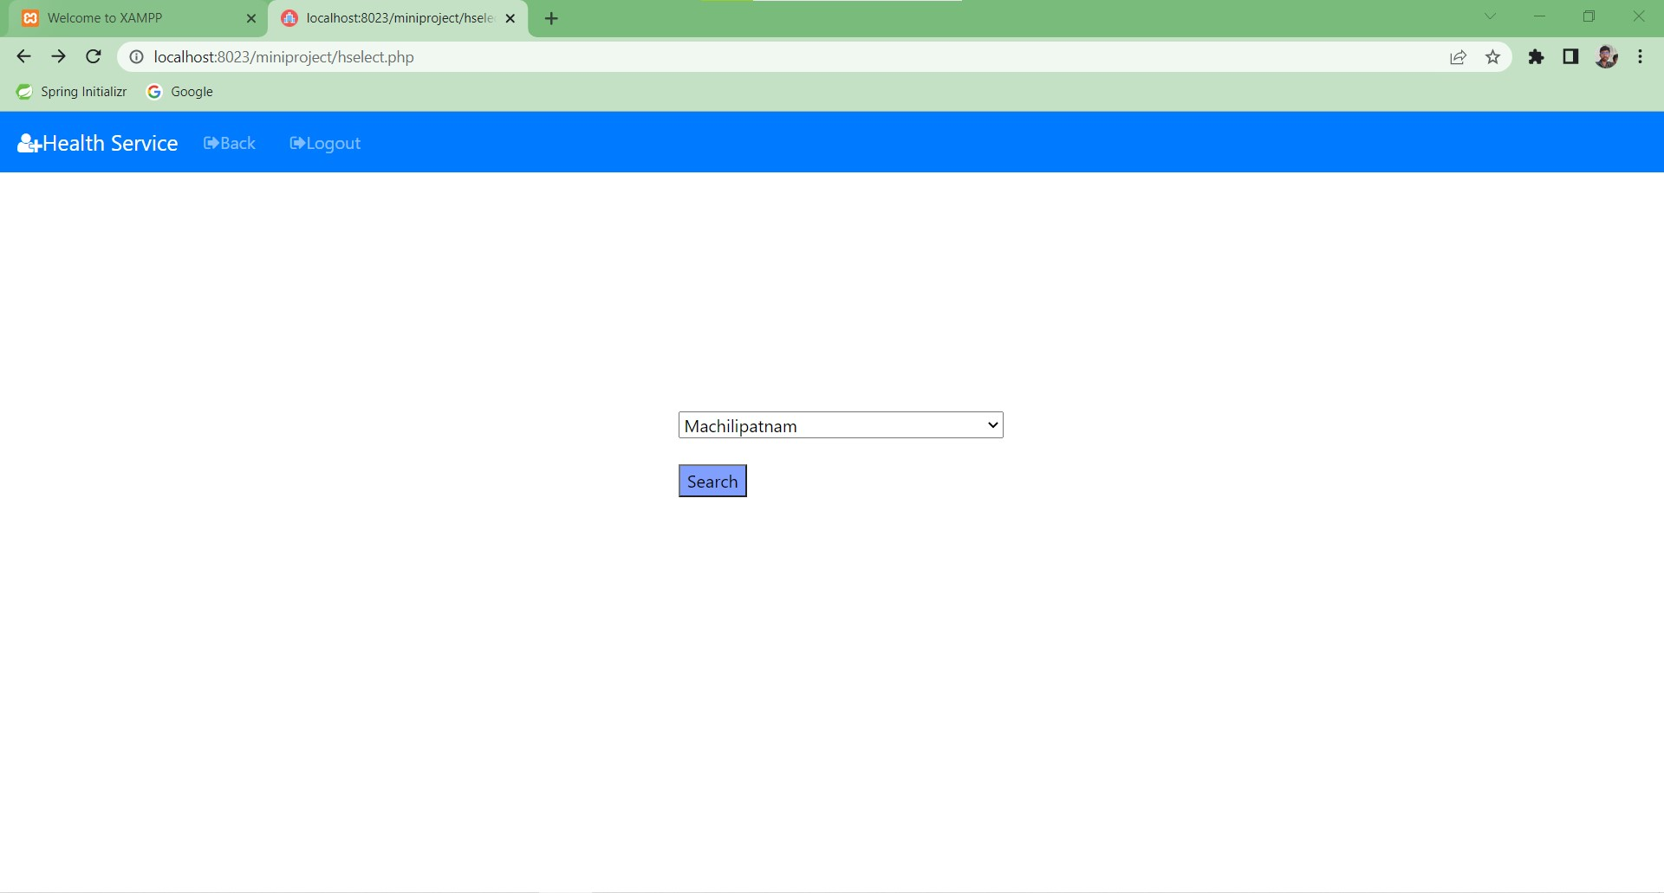

Slide 14
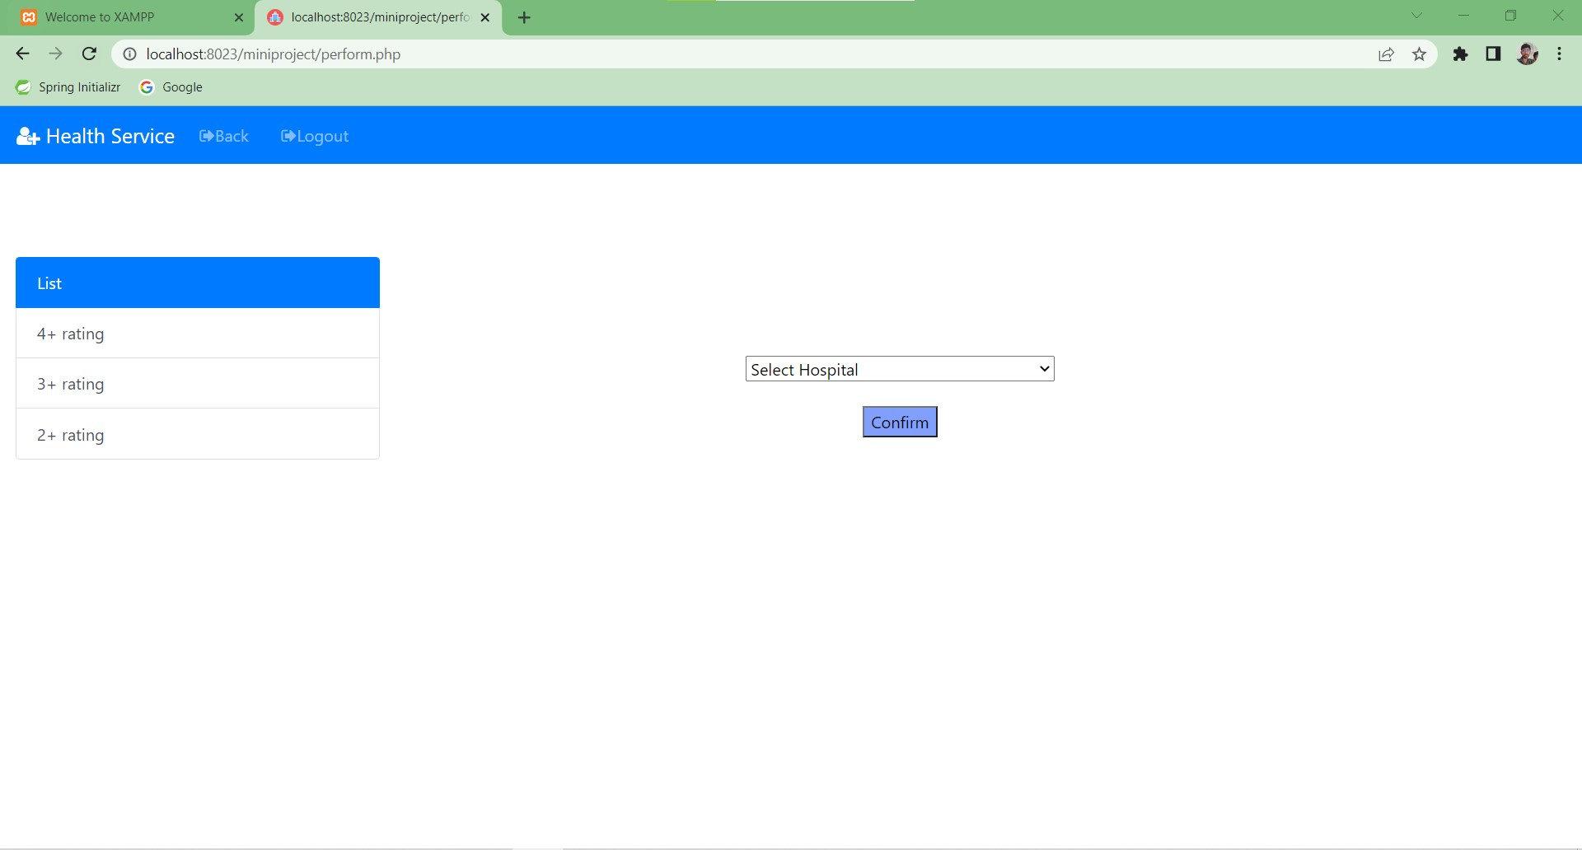

Slide 15
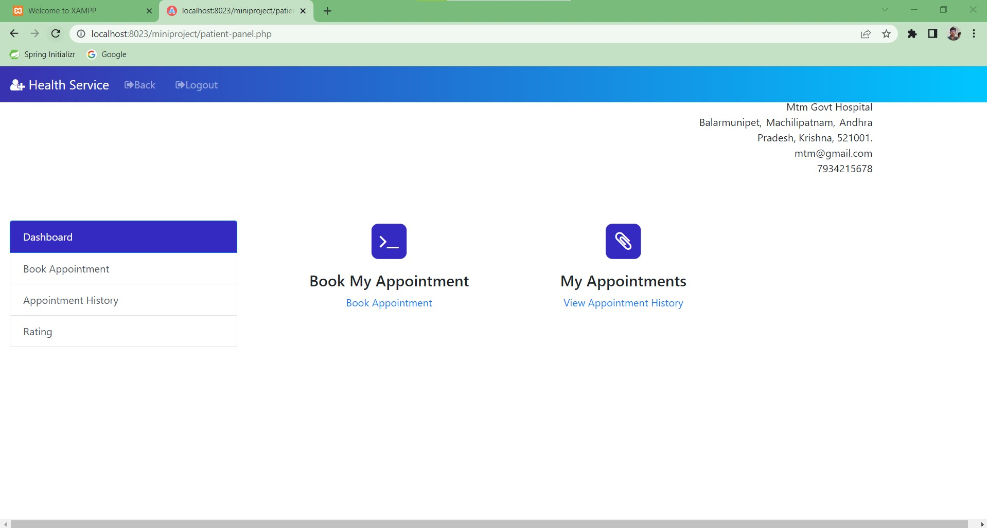

Slide 16
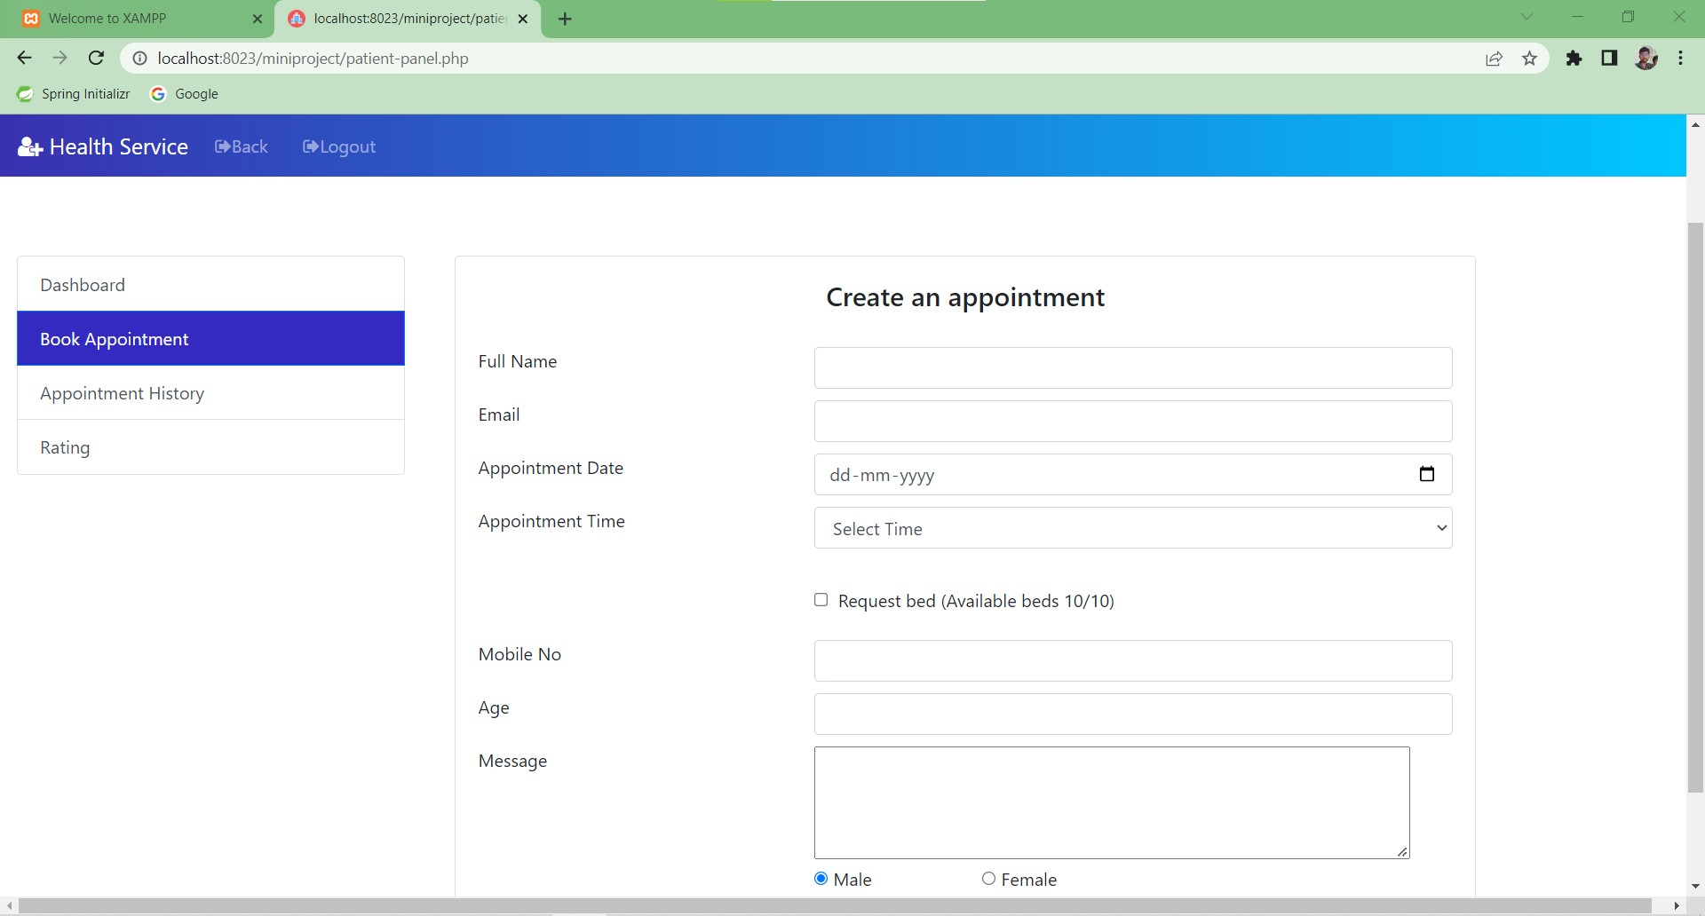

Slide 17
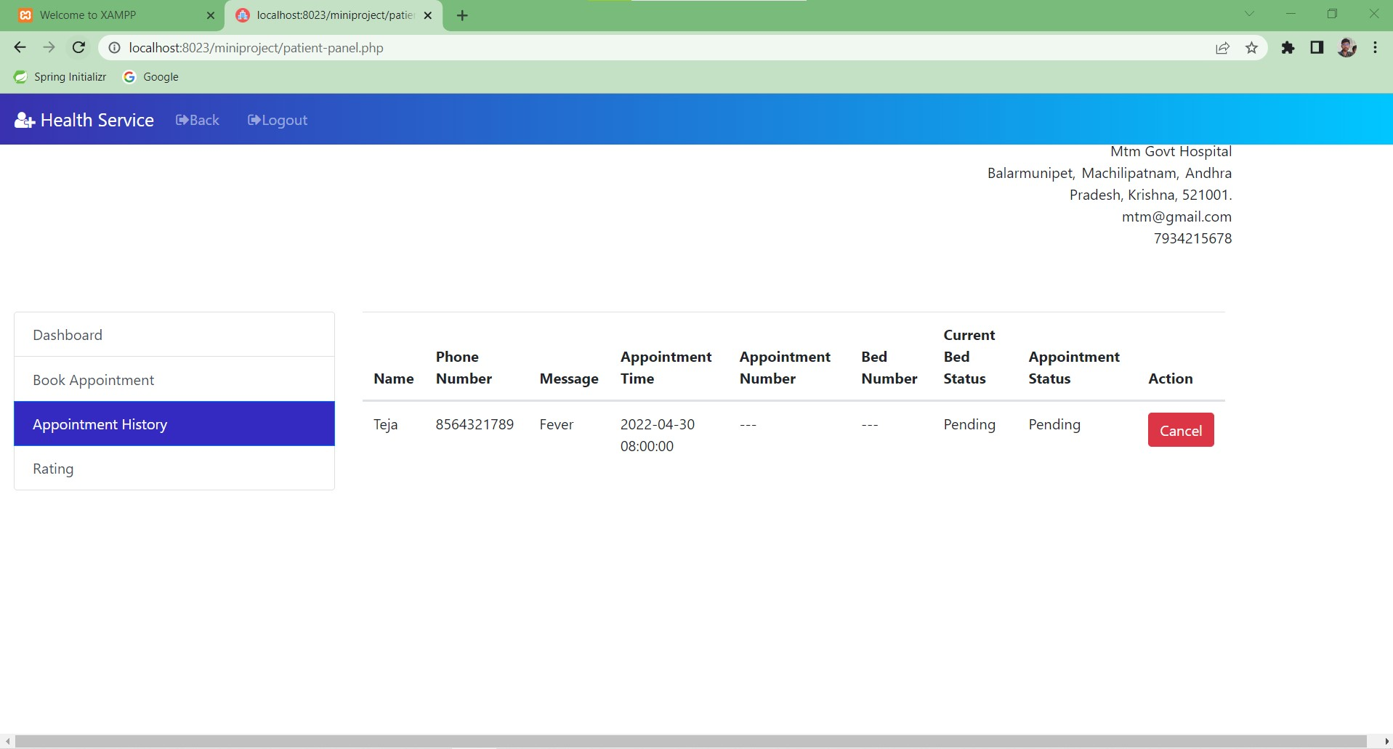

Slide 18
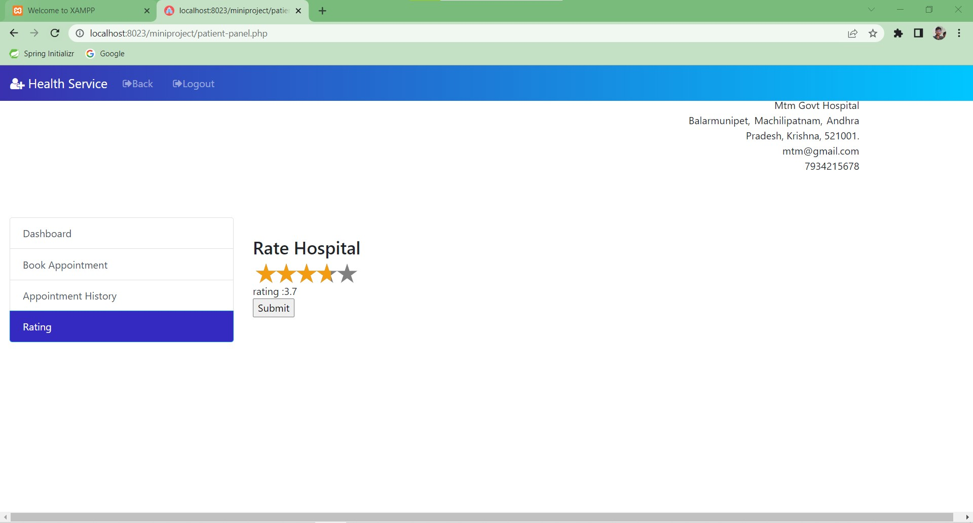

Slide 19
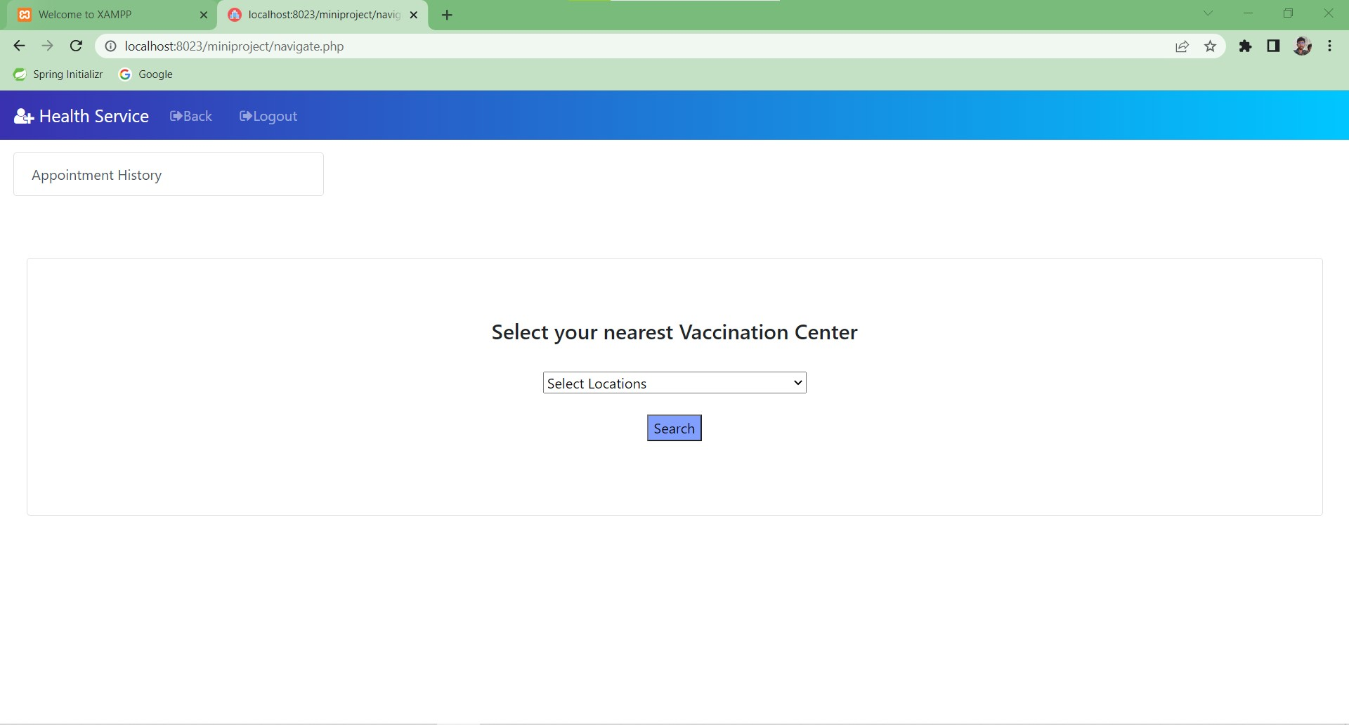

Slide 20
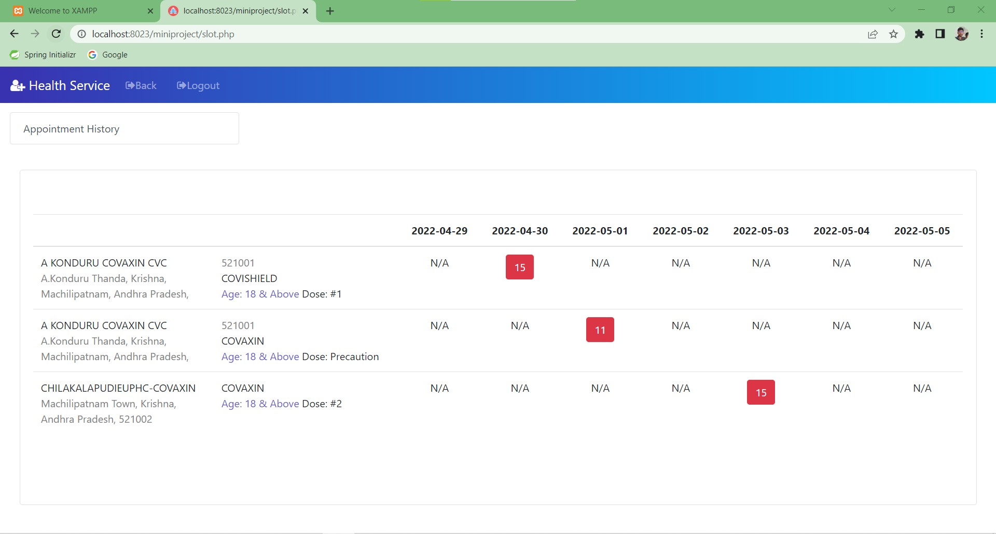

Slide 21
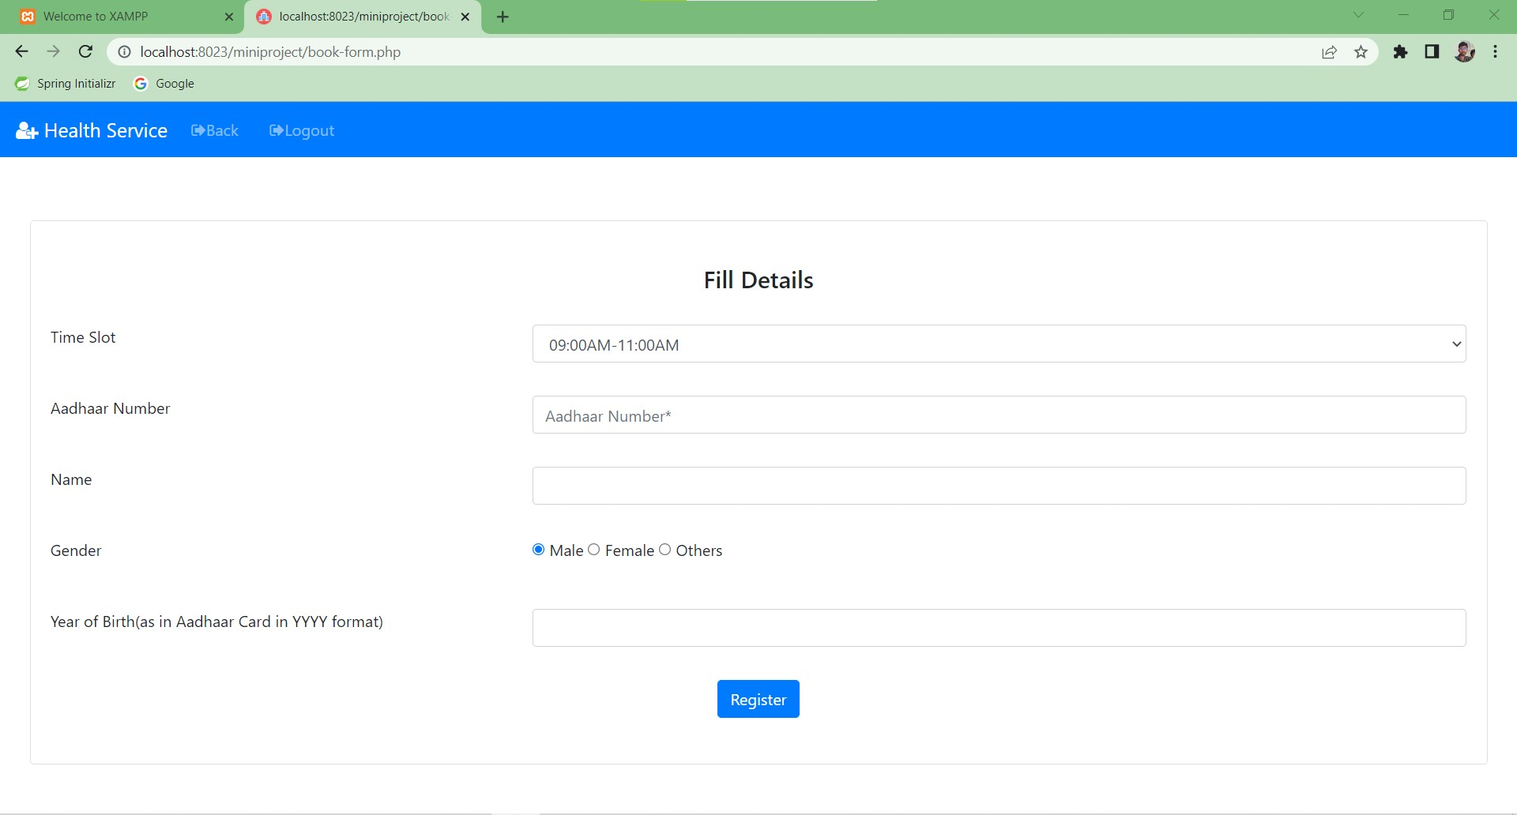

Slide 22
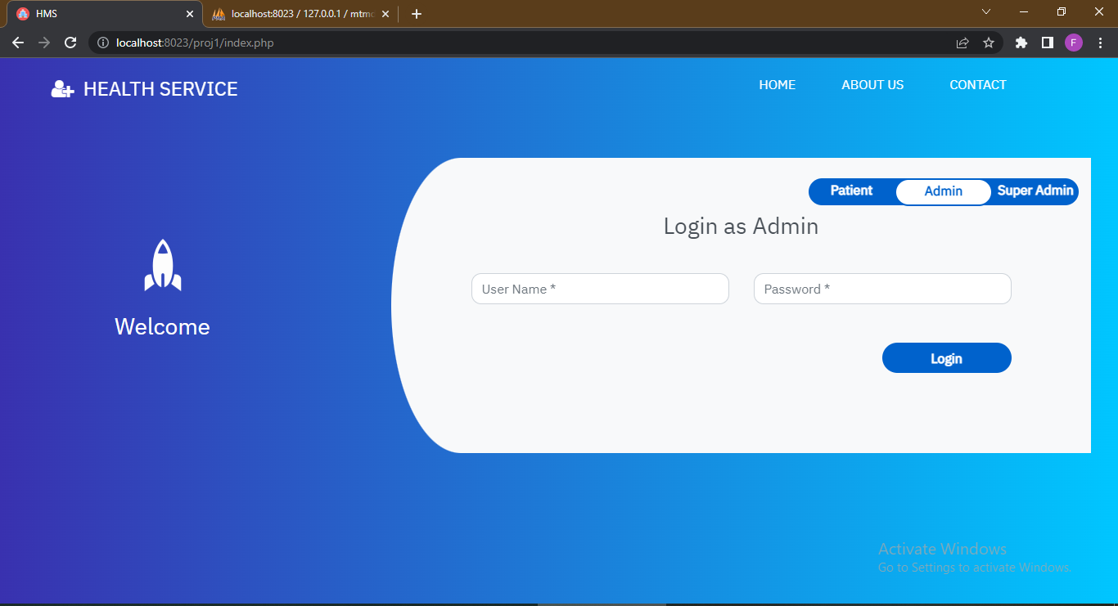

Slide 23
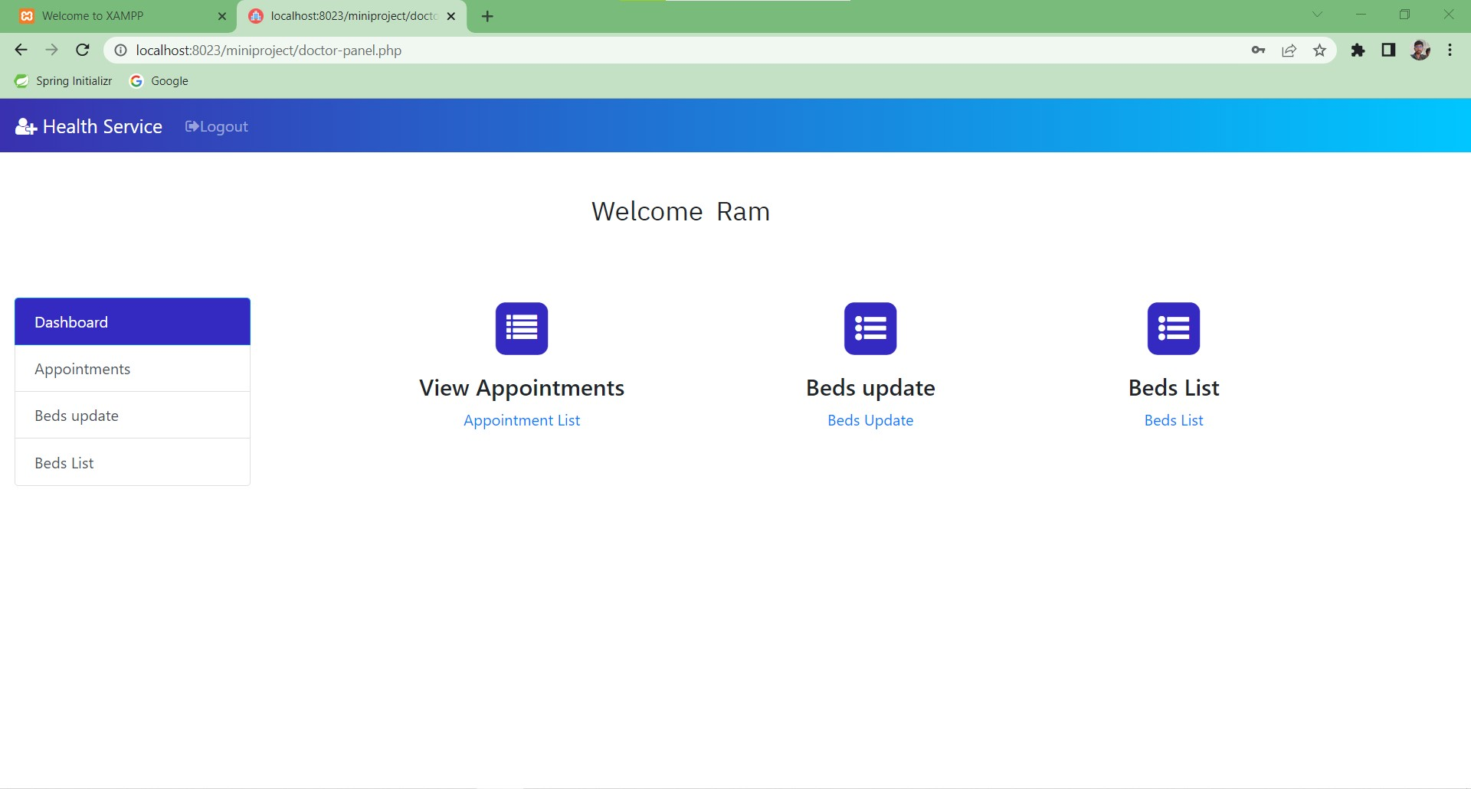

Slide 24
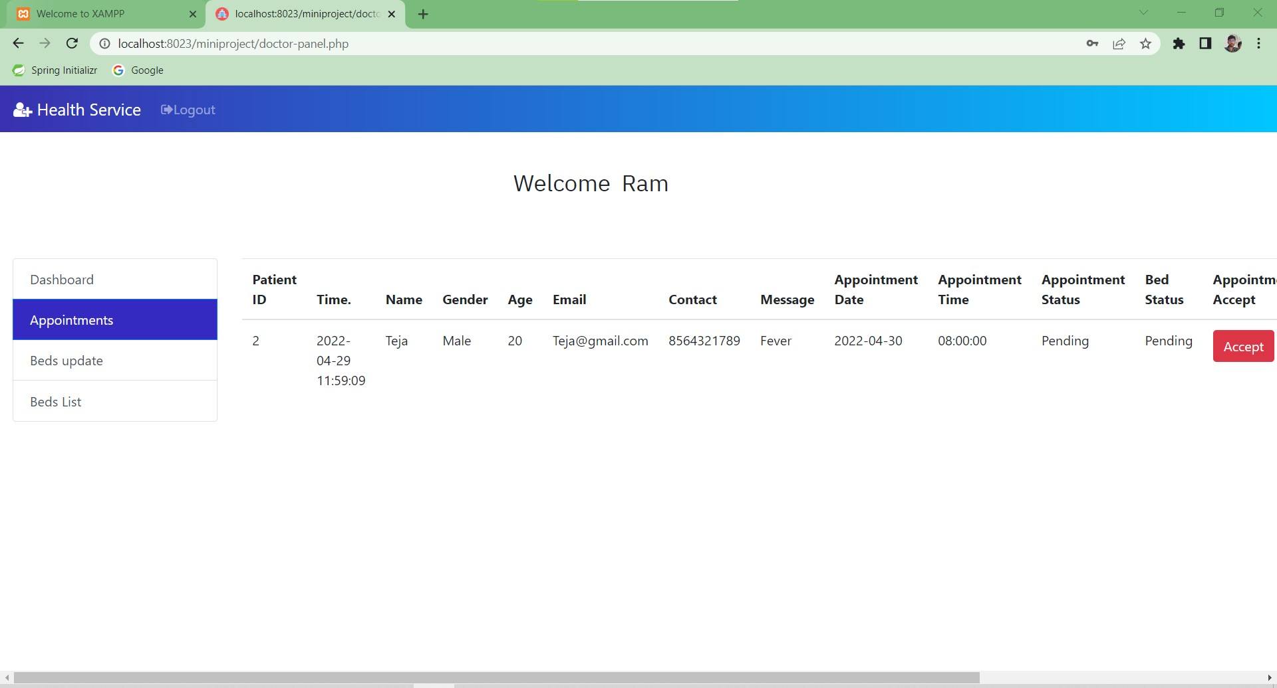

Slide 25
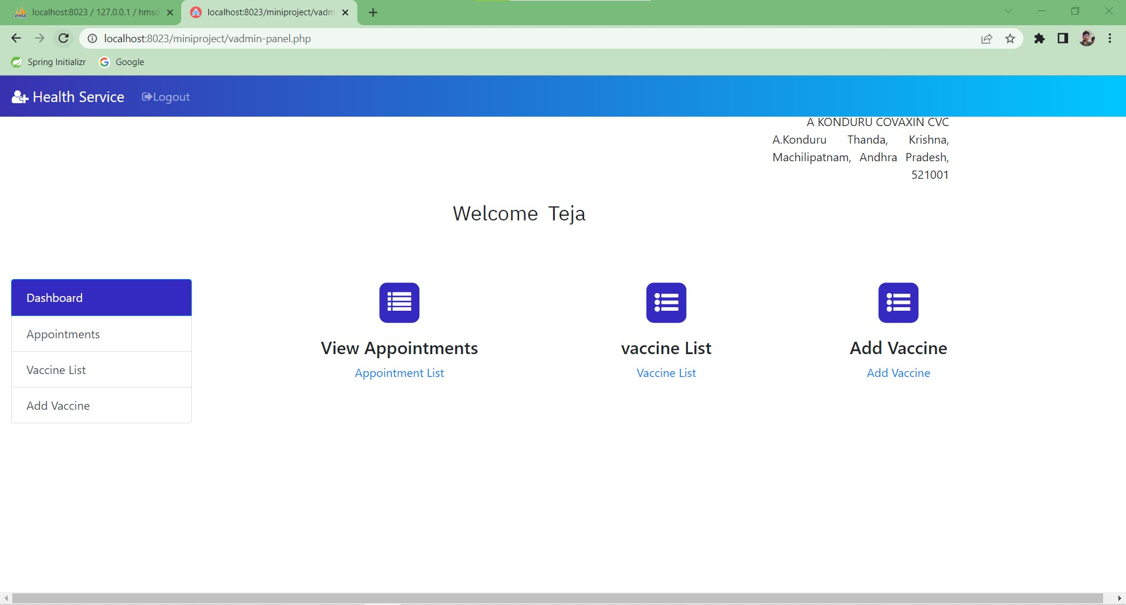

Slide 26
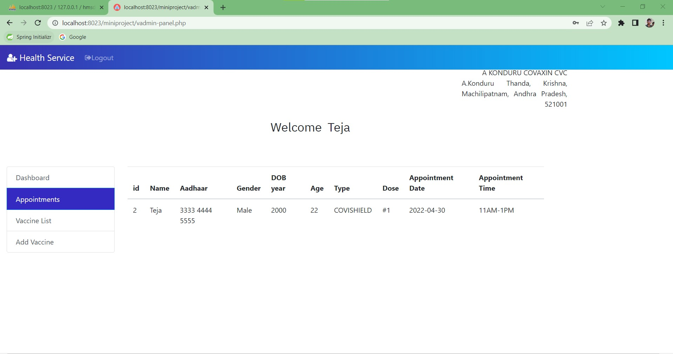

Slide 27
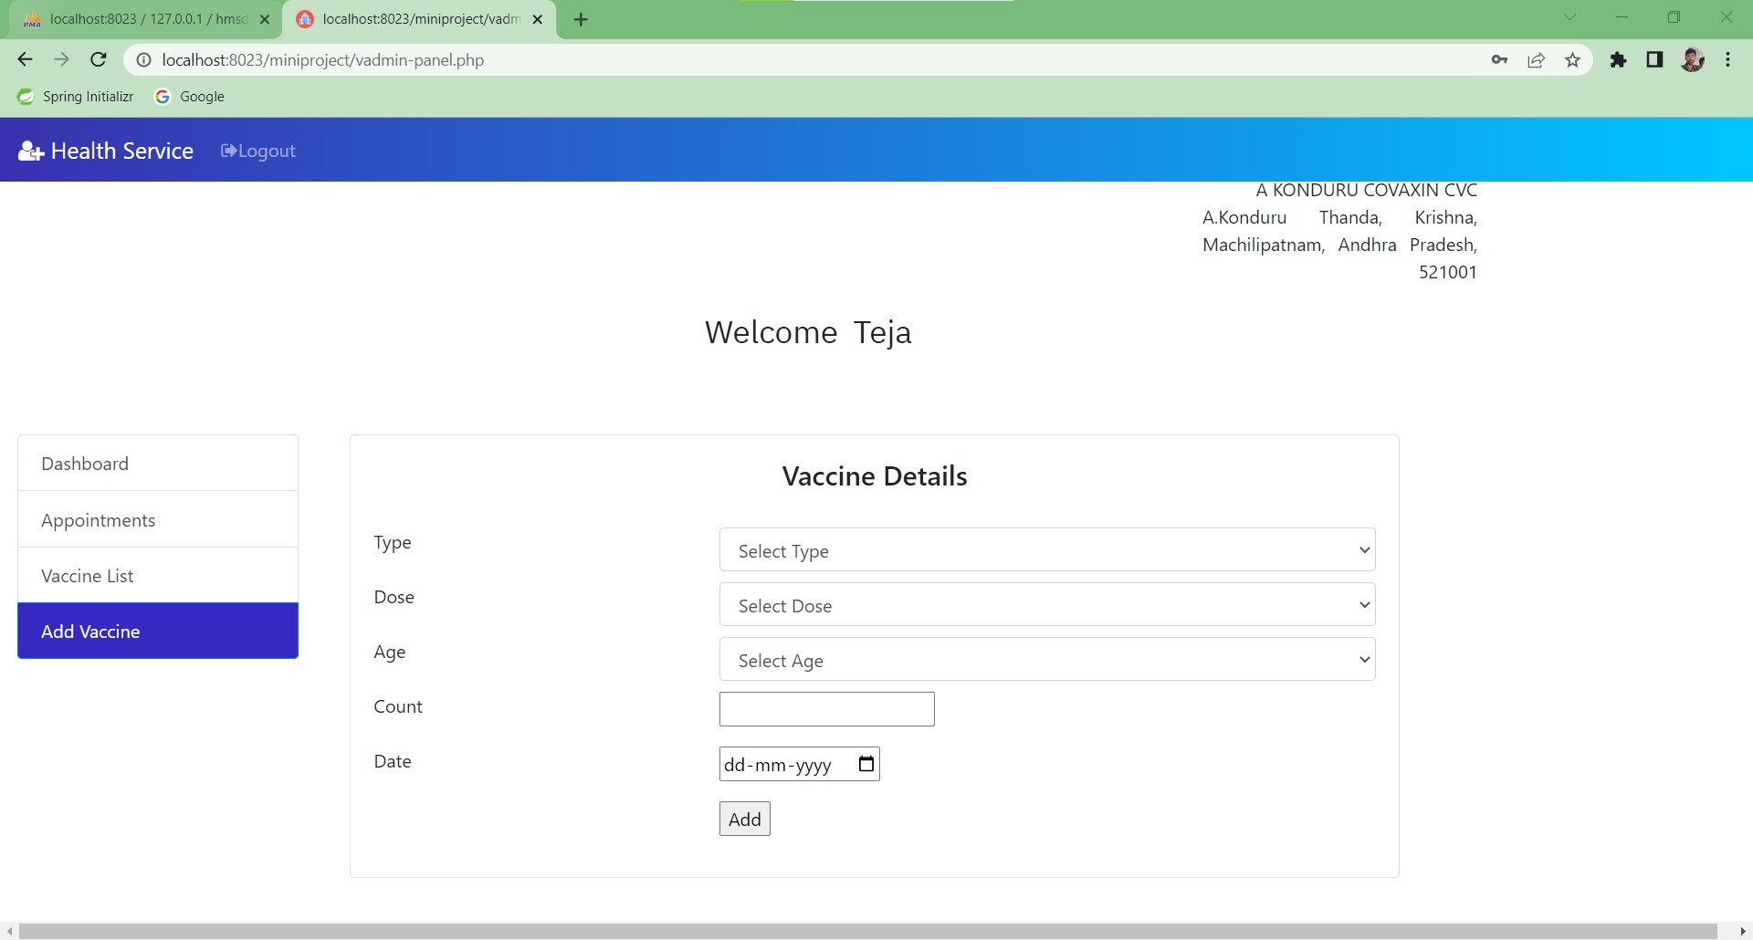

Slide 28
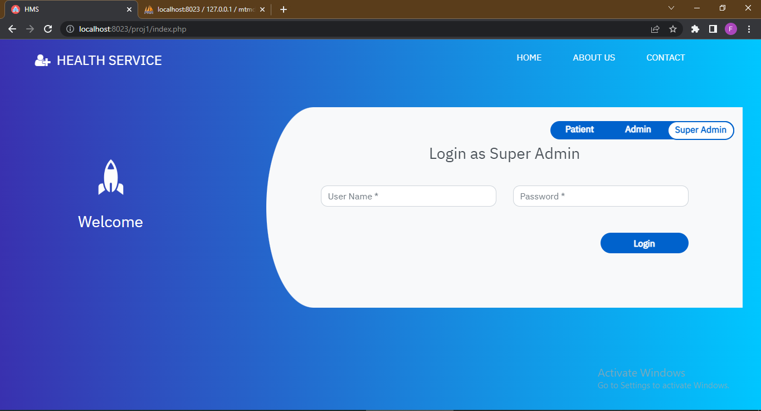

Slide 29
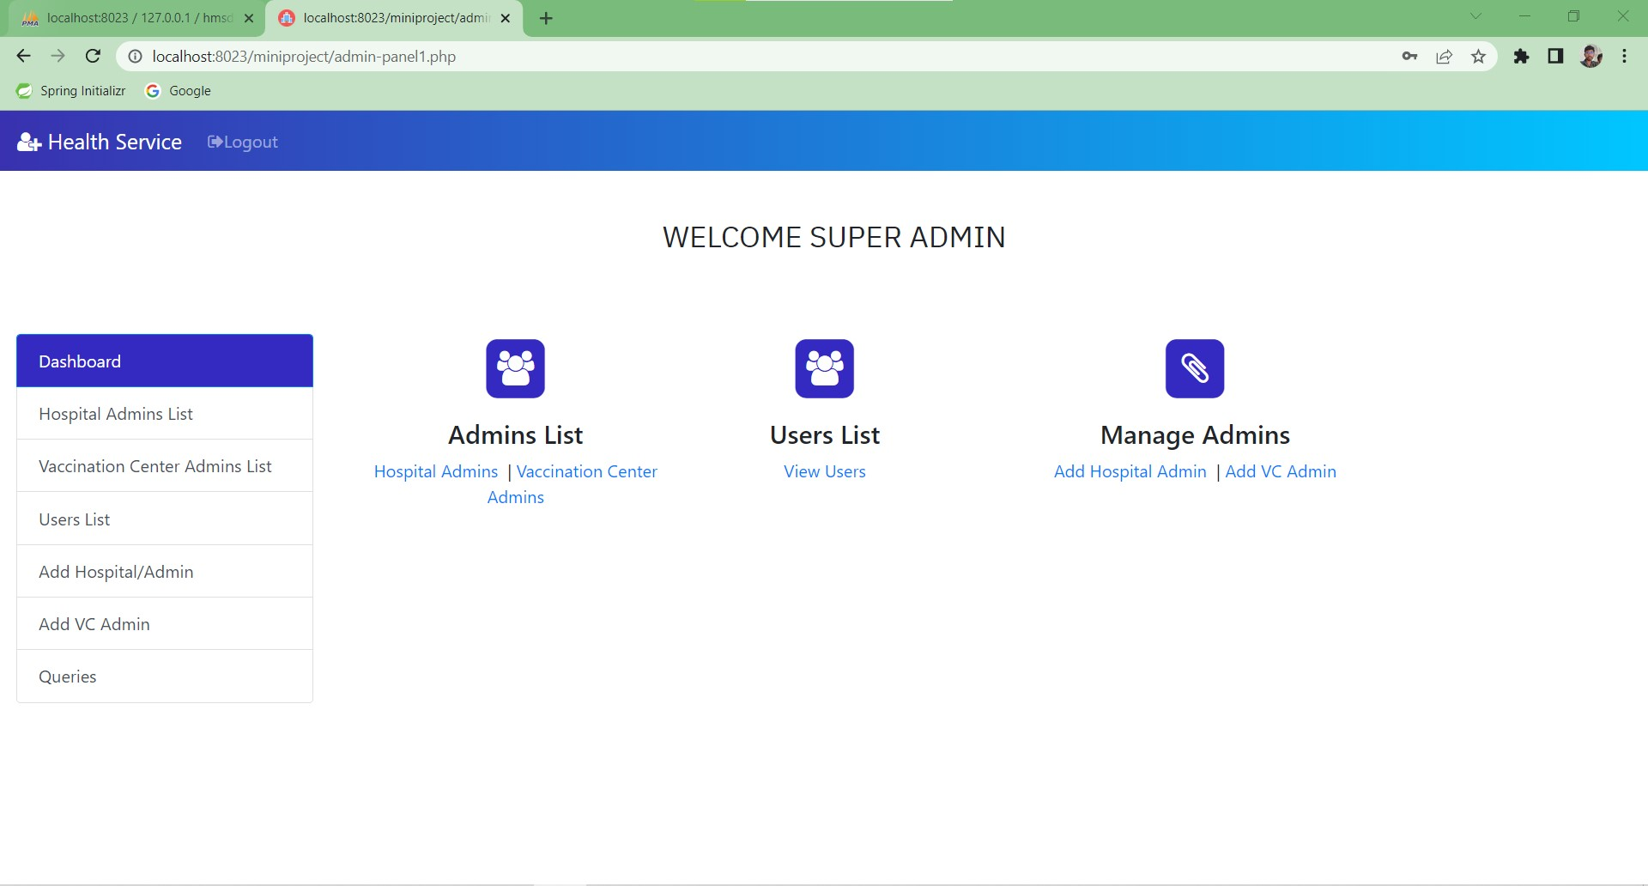

Slide 30
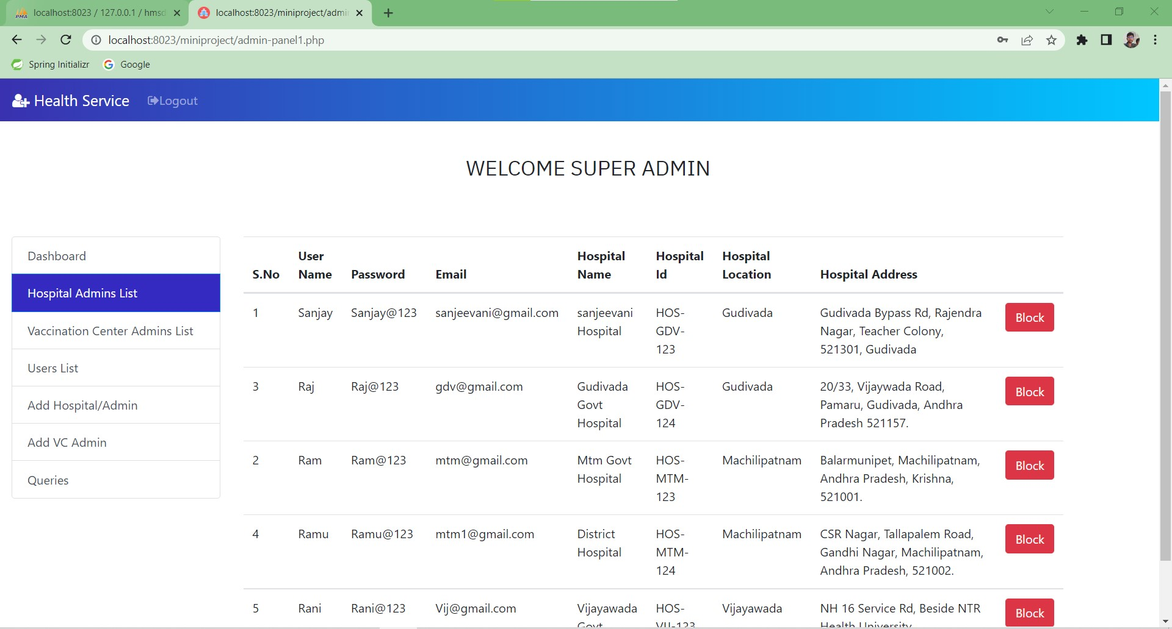

Slide 31


